Slide 1
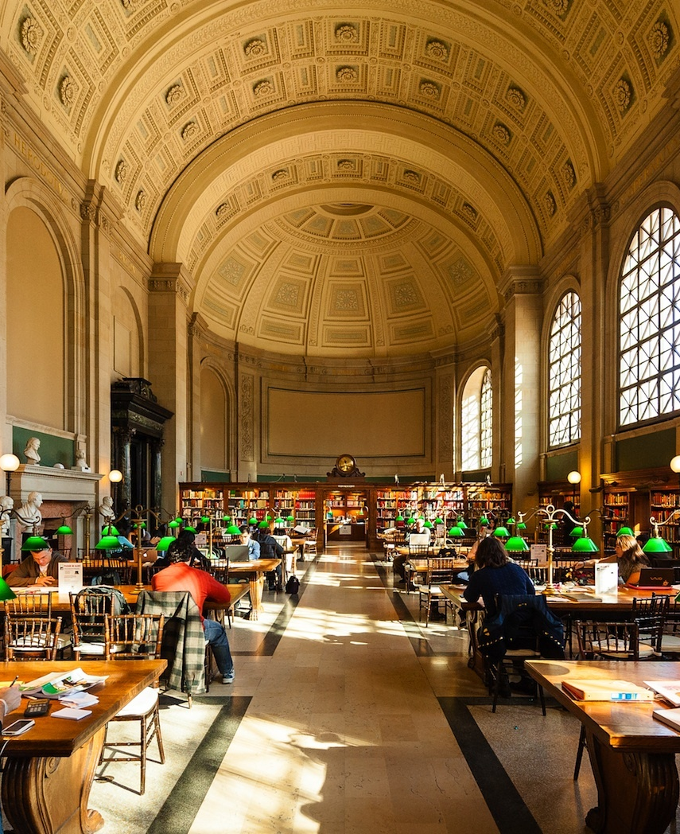
Library Management System Project with Tkinter and SQLite
MANIKANTAREDDY ANNEM

Slide 2
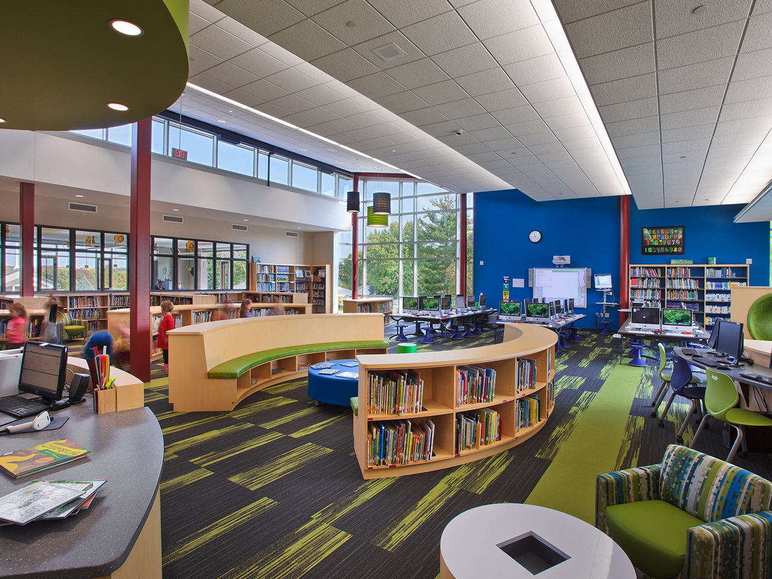
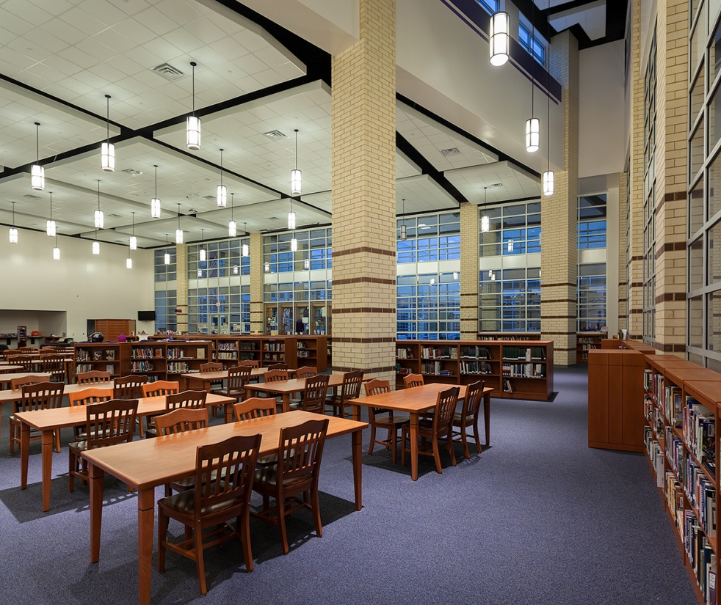
Agenda
Problem Statement
Introduction​
Project Overview
System Architecture
Graphical user interface (GUI) Design ​
GUI Design Principles
Database Design​
Implementation
Future Enhancements

Slide 3
Problem Statement
In educational institutions and public libraries, managing and maintaining the borrowing and returning of books can be a challenging task. A manual system often leads to inefficiencies, errors, and difficulties in tracking book availability and user records. To address these issues, there is a need for an automated Library Management System (LMS) that can streamline the process and provide an efficient way to manage library resources.

Slide 4

Introduction
Overview of the Project:
Our project aims to develop a robust Library Management System using Tkinter, a Python GUI library, and SQLite, a lightweight relational database management system. Through this system, users will be able to efficiently manage library resources, including books, users, and borrowing transactions.
Purpose and Goals:
Our primary aim is to modernize library operations by developing a user-friendly Library Management System leveraging the power of Tkinter for creating intuitive graphical interfaces and SQLite for efficient data management. Specifically, we seek to Providing librarians and users with a simple interface for maintaining and accessing library materials is the main goal of this project.

Slide 5
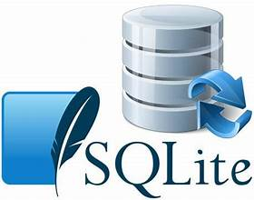

PROJECT OVERVIEW
Introduction to Tkinter and SQLite:
Tkinter: Python library for creating GUIs.
SQLite: Lightweight RDBMS for data storage.
Benefits of Using Tkinter and SQLite:
Tkinter provides an intuitive interface design for the application's GUI.
SQLite offers efficient data storage and management without requiring a separate server setup.
Both Tkinter and SQLite are part of the Python standard library, ensuring accessibility and ease of use.
Scope and Features:
Cataloging, inventory management, circulation management, Intuitive browsing, searching, and borrowing of library materials.
Data accuracy and security through robust database management techniques.
Technologies Used:
Python: Programming language used for development.
Tkinter: Python library for creating GUIs.
SQLite: Lightweight RDBMS for data storage and management.
LIBRARY MANAGEMENT SYSTEM 4

Slide 6
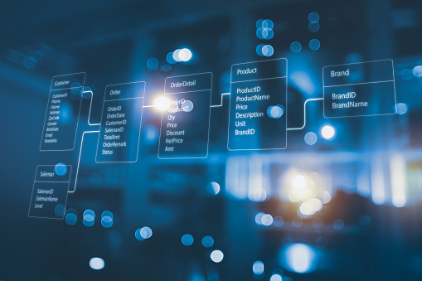
System Architecture
User Interface (UI):
Front-end for user interaction.
Includes login, search, profiles.
Backend Logic:
Core functionality management.
User authentication, data processing.
Database:
Central repository for data.
Stores user info, book details.

Slide 7
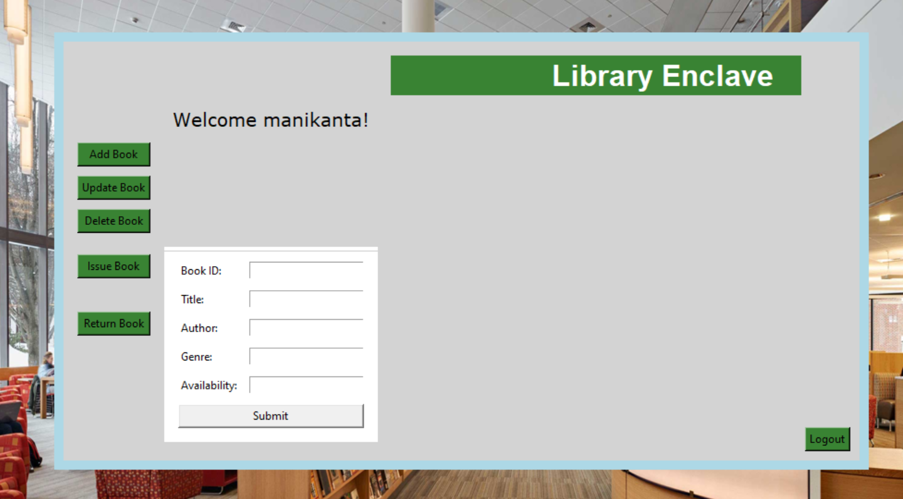
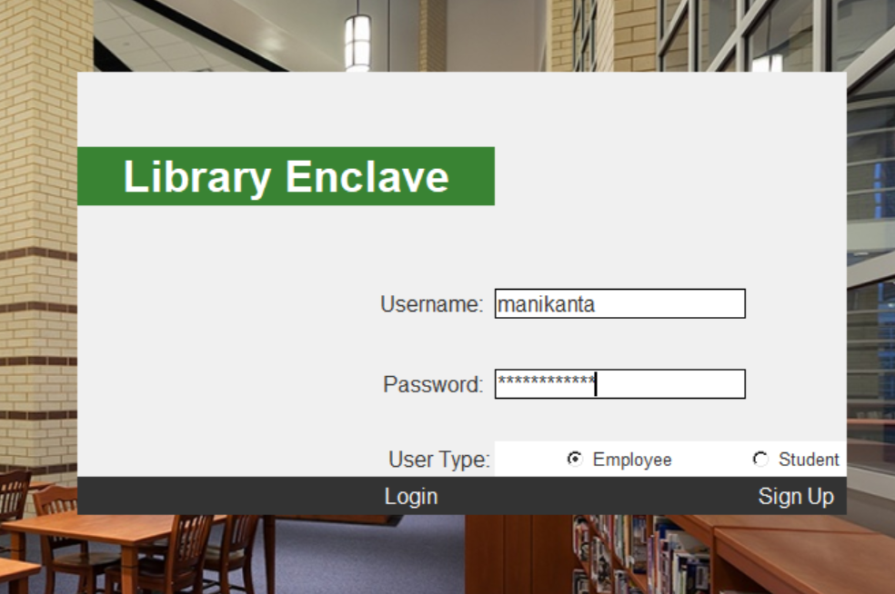
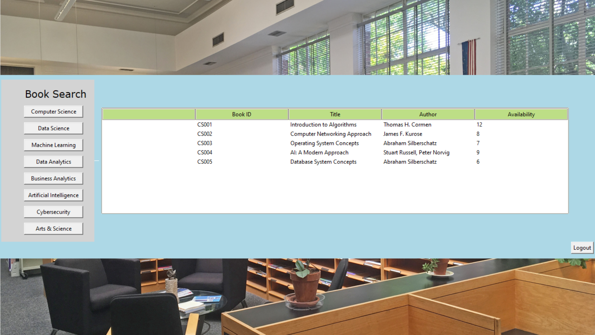
Graphical user interface (GUI) Design

Slide 8

Overview of GUI Design Principles
Emphasize simplicity : Design the graphical user interface to be easy to navigate and understand, ensuring users can perform tasks without confusion.
Consistency in design elements: Maintain uniformity in layout, colors, fonts, and interactions across all screens to provide a cohesive user experience.
Visual hierarchy involves arranging elements on the interface in a way that naturally guides users' attention towards the most important information or actions.
Error handling: Provide clear and concise error messages to help users understand and resolve issues when they occur, improving the overall usability of the system.

Slide 9
Database Design
SQLite Usage:
Schema Overview:
The code utilizes the SQLite library in Python for database management.
It establishes connections to SQLite databases (users.db and books.db) and creates necessary tables if they don't exist.
Books Table: Stores information about books including ID, title, author, genre, and availability.
Users Table: Manages user information with fields for ID, username, password, and user_type (employee or student).
Table Relationships:
Data Integrity and Security:
The code demonstrates the creation and management of two separate tables (books and users) in the SQLite database.
These tables are designed to hold specific types of information related to the library management system.
Measures such as unique constraints on usernames and the use of encryption for sensitive information like passwords are implemented to ensure data integrity and security.

Slide 10
Implementation
Python Language:
Tkinter Usage:
SQLite Integration:
Python serves as the primary programming language for developing the application.
Its simplicity, readability, and versatility make it well-suited for a wide range of tasks, including GUI development and database management.
Tkinter is utilized to develop the graphical interface of the library management system application.
Various Tkinter widgets such as labels, buttons, entry fields, and frames are employed to create an interactive user interface.
Using grid and pack managers, widgets are organized and placed in the application window.
The application integrates SQLite for database operations, facilitating data storage and retrieval.
It establishes a connection to the SQLite database file using the sqlite3 library in Python.

Slide 11

Future Enhancements
Examine more sophisticated search options, such as user reviews and publication year filters.
Analyze how well an application performs with more users and data.
Utilize analytics tools and surveys to collect user feedback.
Apply individualized suggestions based on borrowing history and user preferences.

Slide 12
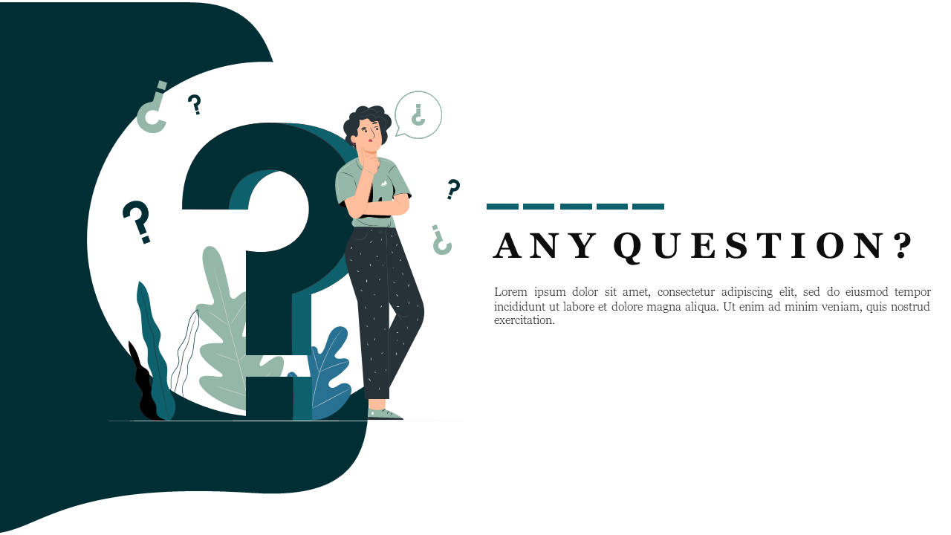
Library Management System
12

Slide 13


Thank you

